Slide 1
How should we be thinking about school improvement & accountability?
Professor Philippa Cordingley
Shonogh Pilgrim
Bart Crisp

Slide 2
Goals for this session
The origins, design and approach of a research-based, formative model for school development - an alternative to Mocksted
A more holistic lens a useful, concrete evidence trail
Examples of how and why it works for Whole Education system
Implications for the accountability system
Exploring perspectives and questions about SKEIN Momentum and accountability for schools in general

Slide 3
Our proposition, summarised
Working within a high-stakes, summative accountability system places huge finance, energy and morale demands on schools and leaders
Skein provides an evidence-base for using evidence formatively, to build capacity in schools and identify & remove barriers to learning for all
Done productive, holistic way different from but predictive of OFSTED and Standardised assessments. Key to this is:
  Focus on overall trajectory ("momentum"), not a single snapshot
  Using tools for evidence gathering and analysis that provide value for practitioners, are sensitive to context and consistent across schools
Our aim is to build a clear, evidence-backed picture of schools’ Zones of Proximal Development, and build on existing capacity for improvement

Slide 4
How does it work?
A process rooted in tools and protocols, based on research by CUREE for Teach First, now carried out in over 90 school
A focus on identifying how schools can spot and build on existing momentum via:
Spotting, enhancing and making use of existing formative evidence re:
  Teaching, learning, curriculum and assessment
  Continuing professional development and learning
  Leadership
  Professional and community partnership
Tools for collecting and analysing evidence re plans and their relationship with the working environment to help colleagues understand and use the reports
(Where appropriate) A CPDL model for leaders to use SKEIN Momentum tools and protocols for peer review

Slide 5
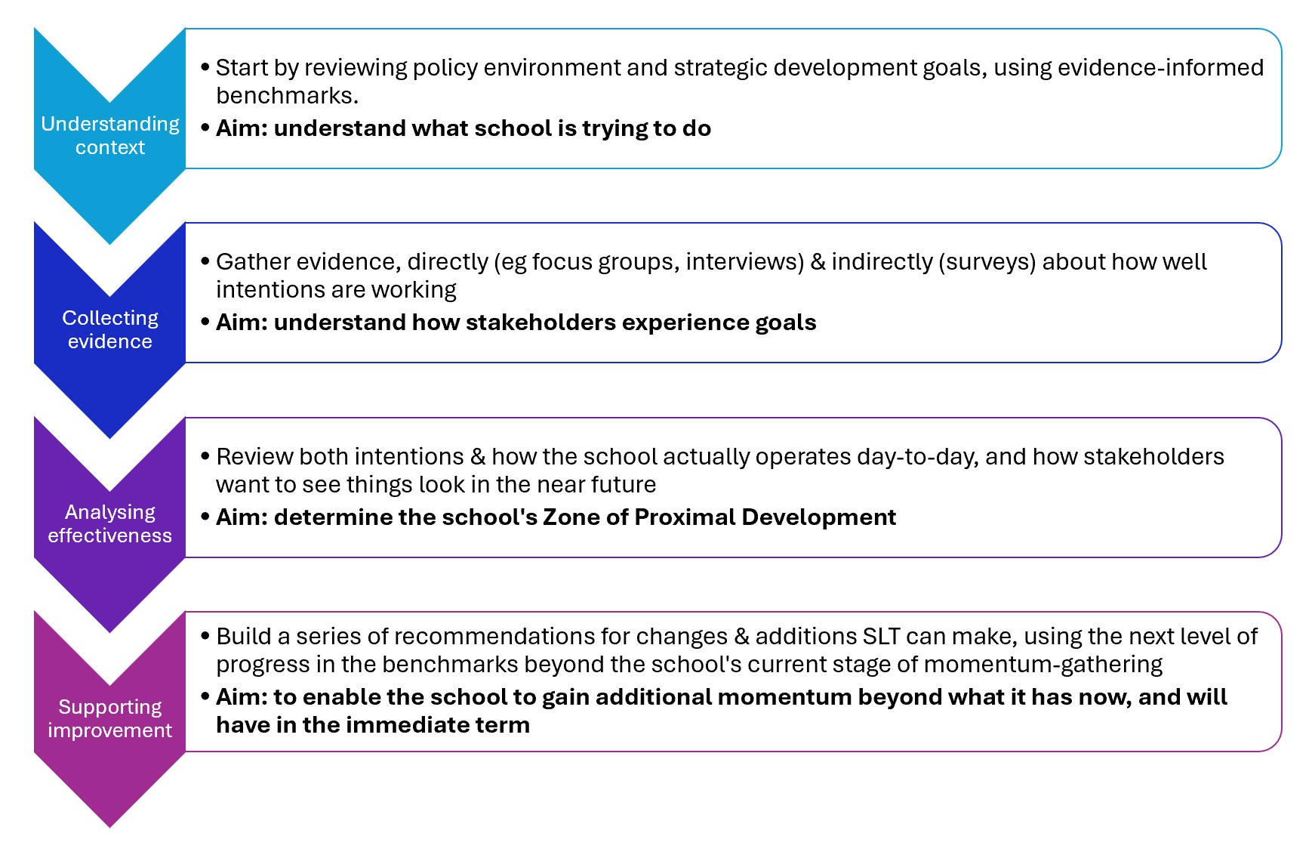
The Golden Thread of SKEIN Momentum

Slide 6
The power of focusing on momentum
SKEIN Momentum focuses on:
Identifying concrete, differentiated recommendations to “start doing y”, “let go of X” AND “augment/do more of P” for all schools
Benchmarks not published to avoid tick box culture - but revealed in recommendations
Framework focuses on building coherence by identifying and removing obstacles to learning for all
Tools
  combine evidential rigour with responsiveness to context at multiple levels
  Enable triangulation and create a clear trail by a range of epxlorations with stakeholders
Breadth of perspectives – especially via the peer-review model to contextualise observations and findings while reflecting on them

Slide 7
Vignette of a recommendation trail - 1
A secondary –
  Survey & focus group data revealed issues with SLT-led coaching, considered important by SLT but less popular with staff than peer coaching.
  Exploration showed that coaching conversations and monitoring and evaluation of it weren’t explicitly aligned with meeting student needs
  Recommendations focused on addressing this from top & bottom, introducing a focus on what both coaches and professional learners contribute to effective coaching conversations, and providing tools for incorporating evidence about learners’ experiences into coaching conversations

Slide 8
Vignette of a recommendation trail - 2
A primary –
  Leaders at all levels in the school have the opportunity to facilitate staff training, and have relevant subject expertise.
  BUT, the school lacked systems to establish a shared and explicit approach to high-quality facilitation of CPDL.
  So one recommendation suggested that SLT consider building an explicit model of CPDL facilitation, supported by tools and resources for all who lead CPD to use to create coherence in, and a shared language around, all in-school CPDL

Slide 9
Challenges and responses
Adding value :
  The holistic focus encourages colleagues to explore how systems intersect and align
  The process and evidence trail engages colleagues with the research and theory underpinning recommendations
  The 2 points above help schools with capacity give structured support to other schools
  Listening to current realities and aspirations helps identify things to build on
  Linking content areas so actions to accelerate momentum in one area also feed momentum in other areas, helps limit the number of foci and makes capacity building more manageable
  Evidence trail and formative goal gives schools with limited capacity recommendations that balance challenge and practicability:
It takes time and effort: effective recommendations generate repeat interest. Requires a champion who can think holistically to start with

Slide 10
SKEIN Momentum & Beyond Ofsted
Overlaps
  Most recommendations (eg schools creating their own performance reviews, supported by external partners) are wholly compatible with SKEIN Momentum
  True with or without peer review, though peer review strengthens the connections
Challenges
  Accountability doesn’t locate CPD, or CPDL, as an improvement driver
  A specific focus on formative recommendations ( which could make the accountability system itself more accountable) is not yet surfacing

Slide 11
Key arguments
Matthew Effect emerging here:
  challenging to build a holistic picture if schools are fighting on many fronts; easier for schools with more momentum. So, it is crucial to put systems & processes in place to ensure the first group are not losing out.
  Ensuring schools have time, space and capacity to engage with structured peer review based approaches is hugely beneficial – but there are huge demands on time and resources and a risk of “rushing to mark”. Imposing demands on schools to do this without also investing in time and capacity building is dangerous
  Providing detail, specificity and transparency in the evidence collection and interpretation tools, at every level of progress, is key to scaffolding peer review
SKEIN Momentum provides an implicit Theory of Change. This analysis prompted us to make this explicit at school and system level, which we are continuing to develop now.
Watch this space and your questions/comments for more information!

Slide 12
Key arguments
  Beyond Ofsted’s call for the inspectorate to be held to account. SKEIN Momentum helps systematise that via the consistent, research-based framework tightly linked to evidence collection and interpretation in every area
  Beyond Ofsted lacks clear mechanisms to examine the drivers of individual teacher and pupil development. Focus group tools, eg re use of evidence and powerful conversations:
    Would provide a granular means of identifying what’s in a school’s ZPD, and would ensure ALL stakeholders have a voice in school accountability.

Slide 13
Over to you
What do you see as the key strengths of a formative approach to school improvement like this one?
What are the weaknesses or challenges you see in what is described here?
What do you see as the most useful components or aspects of school improvement/accountability? What should we be preserving or focusing on?

Slide 14
Contact us
Philippa Cordingley
Philippa.Cordingley@curee.co.uk
@philippaCcuree
Shonogh Pilgrim
Shonogh@wholeeducation.org
@ShonoghP
Bart Crisp
Bart.Crisp@curee.co.uk
@crispy_bart

