Slide 1

The Role of Governors and National Support for Them
Paul Crisp
Centre for the Use of Research and Evidence in Education
www.curee.co.uk
National Leader of Governance

Slide 2
Who am I to say?
National Leader of Governance
Chair: President Kennedy School
Managing Director – Centre for the Use of Research & Evidence in Education (CUREE)
Former college Vice Principal, leadership teacher/researcher and LEA officer

Slide 3

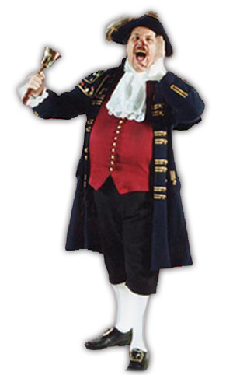

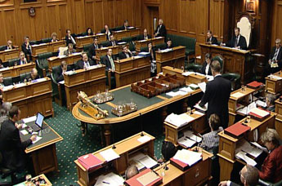


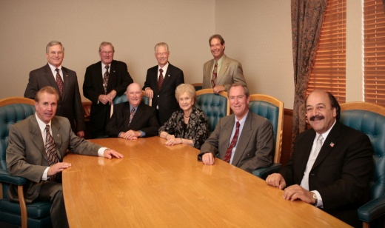

What are we here for?
Local Worthies?
Representatives?
Inspectors?
Experts?
Board of Directors?
Cheerleaders?
Friends?

Slide 4

New focus?
Inspectors?
Local Worthies?
Representatives?
Experts?
Board of Directors?
Friends?
Cheerleaders?

Slide 5
Ofsted on the role
“ ..complements and enhances school leadership by providing support and challenge, ensuring that all statutory duties are met, appointing the headteacher and holding them to account for the impact of the school’s work on improving outcomes for all pupils ” Ofsted 2011
Good governance
“fully involved in the school’s self-evaluation and use the knowledge gained to challenge the school, understand its strengths and weaknesses and contribute to shaping its strategic direction”
Weak governance
“Fail[s] to ensure statutory requirements are met, for example those related to safeguarding. ... the involvement of governors in monitoring the quality of provision is not well enough defined or sufficiently rigorous and challenging”

Slide 6
Some key features of good governance
Trust, openness and transparency – governors and leaders
Well informed and supported by good data
Encourages honest, insightful self-evaluation
Takes and supports hard decisions where needed
Clarity about boundary between strategic and executive
Have personal experience of the school (visits, lesson observations etc)
Efficient , well organised with good delegation

Slide 7
Balancing support & challenge
Support
Listen to ‘blue skies’ ideas
Face difficult staffing issues
Challenge
Do not be bamboozled
Compare and benchmark
Use data not anecdote
Resist factions and cliques
Learn to love RAISE and FFT!
Respect

Slide 8
Governors’ role in school improvement
Pupil achievement and wellbeing is strategic ‘core business’ of the school and governors
Many contending ‘magic bullet’ models of school improvement
Do governors have to be experts to choose the ‘right’ model?
No – but...
You have to be willing to grapple with the concepts and the evidence
You cannot just leave it to the ‘professionals’

Slide 9
E.g. Leadership priorities
Compelling evidence about the impact of leadership on pupil outcomes through:

Slide 10
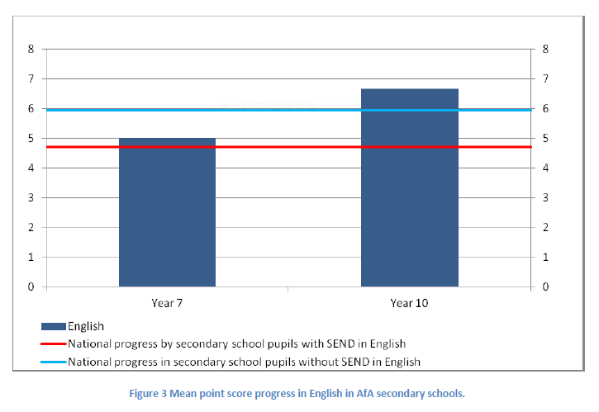
E.g. Programmes with proven impact
Achievement for All – significant improvement for children with special needs in mainstream schools

Slide 11

E.g. CPD which improves pupil learning
Coherent international evidence that CPD for teachers benefits students if it is:
collaborative – involves staff working together,
supported by specialist expertise;
focused on aspirations for students – which provides the moral imperative and shared focus;
sustained over time;
exploring evidence from trying new things to connect practice to concepts

Slide 12
The jury – not the judge?
Expect to have the approach explained so you can understand it
If you don’t understand it, it might not make sense
Expect to see evidence of efficacy
Ask the ‘stupid question’
Look at the data – wrestle with the numbers
Demand tables, graphs and charts

Slide 13
Where can I get support?
National Leaders of Governance (NLG)
Pilot reviews of governance
Regional providers of licensed CoG training
On-line training (e.g. GEL, Modern Governor)
Various on-line resources (e.g. NCSL website, DfE, Clerk to Governors
Individual consultants
Local authority governors’ support service
The Headteacher!

Slide 14
What is a National Leader of Governance
According to NCSL:
National Leaders of Governance are highly effective chairs of governors, who will use their skills and experience to support chairs of governors in schools and academies for a variety of reasons. The chair may be new, governors may want to focus more on school improvement, or need support in dealing with significant strategic challenges – for example becoming a federation or converting to academy status.
Their role is to support CoGs and tend to work through:
Coaching;
Helping with understanding data;
Providing additional infomation
Brokering access to other support (usually via NCSL)

Slide 15
What do they deal with?
Most common issues are:
  New chair finding his/her feet
  Supporting chair of school in measures with weak or missing senior leadership
  Developing effective challenge role (rather than just support)
  Understanding data for challenge
  Contemplating or undertaking structural change (e.g. Federations, academy)
  Relationships with head
  Relationships between governors
Available free on request to NCSL

Slide 16
Pilot reviews of governance
Triggered by Ofsted grade 3 judgement (or worse)
Particular findings of weakness in governance (as distinct from leadership)
Review recommended by Inspector but non-mandatory [But would emerge as issue during monitoring]
Designed as a ‘supported self-review’
Currently only for HMI led inspections
In pilot until Summer (around 100 expected)
Then predicting 400 per term

Slide 17
Example of Ofsted recommendations
Improve leadership and management at all levels, including leadership in the classroom, by:
improving the rigour with which assessment records about pupils’ learning and progress are collated, moderated and analysed
using this improved information to analyse where further or different action is needed to enable pupils to learn more across the curriculum
using a broad range of evidence to make robust judgements about the quality of teaching
using this range of evidence to provide teachers and other staff with the appropriate level of training, support or challenge, according to their individual needs
ensuring that governors receive accurate information about pupils’ progress and teachers’ performance so that they can challenge and support the school appropriately.
An external review of governance should be undertaken in order to assess how this aspect of leadership and governance may be improved.

Slide 18
Review process
Initial exploratory discussion to focus on key areas for action
Reviewer gathers data (documentary, discussion with CoG, Head , other governors)
The key foci will determine the kinds of evidence and process to follow
Feedback session with CoG, Head, other governors/SLT to set out:
Areas for improvement
Action plan
NLG produces short written report recording outcomes

Slide 19
Benchmarks
NLG’s job includes helping governors review their performance against national benchmarks
Governance graded Strong, Sound or Weak against 9 Criteria
  Vision, ethos, strategic direction
  Self evaluation
  Support and strengthen school leadership
  Challenge SLT on teaching, achievement, behaviour and safety
  Use of performance management systems
  Financial management
  Meet statutory duties
  Engage with stakeholders
  Use Pupil Premium etc to overcome barriers to learning

Slide 20
Example criterion
Ofsted Evaluation Criterion | 2. How well governors contribute to the school’s self-evaluation and understand its strengths and weaknesses
Strong Governance all characteristics of ‘sound’ governance plus the following: | Governors have a detailed and accurate understanding of the school's overall performance. Governors have an understanding of the data which they use to cross reference and challenge what they are told by school-leaders Governors regularly evaluate their own effectiveness and this informs the evaluation of school leadership.
Sound Governance | The Headteacher provides GB with a range of information including external views and performance data to enable the governors to have confidence in the schools evaluation of its performance. Governors have a balanced and accurate view of the schools main strengths and priorities for improvement. The GB includes members with appropriate skills and understanding who have the ability to engage in self evaluation. Governors’ visits inform their knowledge of the school. The School Development Plan (SDP) is clearly aligned to school self-evaluation and addresses any improvement priorities that have been identified. The SDP indicates governor monitoring of progress in achieving key improvement priorities. Minutes and discussions demonstrate that governors are using their time effectively to engage with school self-evaluation.
Weak Governance | Governance in this area is weak if all of the characteristics of sound governance are not evident.

Slide 21
... And finally
If governors ever were “local worthies who see being a governor as a badge of status” they can’t be any longer
Government tending to view the Board as the directors (even in community schools) – and a review of governance currently under way
Ofsted increasingly challenging governors’ effectiveness in holding the school to account
A wide array of support available but less and less of it free
Governance has to be seen as a significant feature of school leadership and funded appropriately for e.g.:
  Training
  Specialist advice and consultancy
  Professional support and administration

Slide 22
Contact details
Paul Crisp
Managing Director
Centre for the Use of Research & Evidence in Education
4 Copthall House
Station Square
Coventry CV1 2FL UK
paul.crisp@curee.co.uk
www.curee.co.uk
T: +44 (024) 7652 4036
F: +44 (024)7663 1646

