Slide 1
The contribution of research to teachers’ professional learning and development
Philippa Cordingley
Centre for the Use of Research and Evidence in Education (CUREE)

Slide 2
The evidence base
A review of research about effective teacher engagement with the research of others and/ or their own research and its role in CPDL (Bell et al, 2010)
A series of 4 EPPI reviews about effective CPD ( Cordingley et al)
A New Zealand Best Evidence synthesis (BES) about effective CPD (Timperley et al, 2007) and one re effective leadership contributions to teacher and pupil success (Robinson et al, 2009)
A review of work based professional learning for teachers in preparation for MTL – and a key shift towards continuing professional development and learning

Slide 3
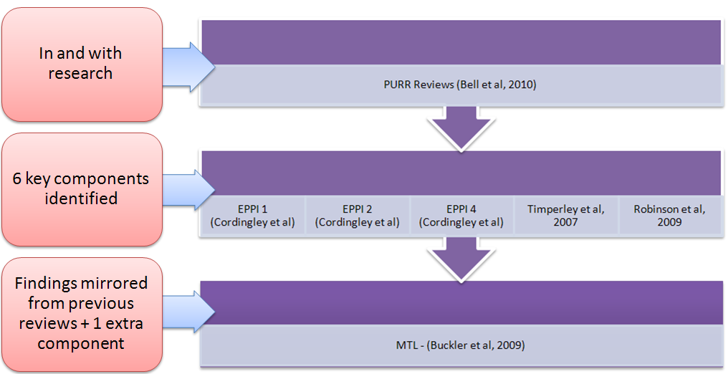
The contribution of the reviews

Slide 4
Established features of effective CPDL
Contribution of specialist external expertise:
Making use of external expertise, including expertise in the form of research evidence, to support planning in particular;
However, use of external experts no guarantee of success; this depends on pedagogical content knowledge of providers.
Collaborative, structured peer support: especially use of reciprocal risk taking and professional dialogue rooted in evdeicne from experiments with pupils as core learning strategies.
Use of data or evidence to challenge prevailing orthodoxies: particularly low expectations of students and beliefs about how to teach particular curricula most effectively.
Source: Cordingley, P. (forthcoming) The contribution of research to teachers’ professional learning and development, Paper Commissioned by the BERA-RSA Inquiry.

Slide 5
Features of effective CPDL (cont.)
Enquiry-oriented learning: Supported by use of tools and protocols to discipline learning and secure coherence and progression:
Learning to learn from looking – though exploration of evidence about pupil outcomes in data rich settings; and through observing teaching and learning exchanges, especially when experimenting with new approaches;
Focusing on why things do or don’t work in different contexts to develop an underpinning rationale or practical theory alongside practice.
Enquiry-oriented leadership to create research-rich conditions:
Time to engage – with one or two exceptions, an extended time frame appears to be needed to develop and embed teachers’ professional learning.
Encouragement and modelling, including specialist coaching
Proactivity – taking responsibility for creating and using opportunities for professional learning within day-to-day school life.
Source: Cordingley, P. (forthcoming) The contribution of research to teachers’ professional learning and development, Paper Commissioned by the BERA-RSA Inquiry.

Slide 6
The Engagement Spectrum
Engagement with Research
Engagement in Research

Slide 7
Categories of Research Engagement
Reviews came across 3 categories:
researcher-led, larger studies (Academic studies)
teacher-initiated small scale studies (TISS studies)
masters-based teacher enquiry (Masters based studies).
All studies were linked with benefits for both teachers and pupils so there was no implication that one approach is more effective than another.
Notes:
researcher-led, larger studies - (academic studies) which involved researchers and teachers as joint participants in research projects designed by academic researchers.
teacher-initiated small scale studies (TISS studies). These studies were reports of substantial practitioner research undertaken with specialist research support for the explicit purpose of improving practice and evaluating its impact.
Masters-based teacher enquiry (Masters based studies). These studies were undertaken by teachers within a Masters programme with specific requirements about publication.

Slide 8
Definition
Challenge
Categories of Engagement
Teacher-led
TISS studies
Masters-based studies
Co-designed
In
Engaging In & With Research
With
Co-produced academic studies
Most studies from CPD Reviews
Researcher-led larger studies
Researcher-led
Adapted from: Bell et al. (2010) Report of Professional Practitioner Use of Research Review: Practitioner Engagement in and/or with Research, Coventry: CUREE, GTCE, LISI & NTRP.

Slide 9
The Engagement Spectrum
At one end of the spectrum:
activities were wholly planned, implemented, analysed and reported by practitioners.
teachers drew on support from (e.g.) HEIs, Local Authorities and specialist organisations.
teachers involved in data collection, review, observation and refinement of questions and evidence, analysis and reporting
teachers used published research of others
Engaging with others’ research represents a change in England

Slide 10
The engagement spectrum - education
At the other end of the spectrum:
research was planned, analysed and reported by researchers.
active involvement of practitioners in implementation, data collection and review
teachers introduced to research findings and underpinning rationale/ theory, by researchers
support to help teachers interpret findings and adapt them for their contexts.
but not identifying questions, analysis, interpretation or reporting

Slide 11
The contribution of research at different stages of teachers’ working lives
No empirical evidence re differences in the benefits of using research to promote CPDL at different stages
Nor evidence that key components of effective engagement in and with research varied significantly across career stages
Effective schools facilitate key elements for teachers at all career stages
A more recent interpretative review comparing evidence about teachers’ and leaders’ professional learning (Bell and Cordingley, 2012) highlights that effective professional learning for leaders was linked with a number of additional factors including:
greater emphasis on external sources of peer support;
flexible non-linear programmes;
careful identification of starting points and recruitment; and
the use of professional standards as a framework for strengthening the leadership of Learning (Bell, 2012).
Notes:
no empirical evidence in response to BERA’s question about differences in the benefits of using research to promote professional development at different stages of teachers’ working lives.
Nor evidence that the key components of effective engagement in and with research varied significantly across career stages; instead what emerges is a coherent shape to CPDL across the professional life course.
Effective schools facilitate the key elements of CPDL for teachers at all career stages, less effective schools invest more heavily in specific contexts such as entry to the profession and the early years of practice or when teachers are struggling to meet pupils’ needs.
A more recent interpretative review that compared evidence about teachers’ and leaders’ professional learning (Bell and Cordingley, 2012) did highlight that effective professional learning for those in leadership roles was linked with a number of additional factors including:
greater emphasis on external sources of peer support;
flexible non-linear programmes;
careful identification of starting points and recruitment; and
the use of professional standards as a framework for strengthening the leadership of Learning (Bell, 2012).

Slide 12
Questions raised
How can we create processes which have the effect of helping schools to recognise and be more confident in drawing down specialist expertise from research?
How can we encourage the development and mediation of research based tools to sustain and embed CPDL within day to day practices and provide coherence?
A focus on the skills needed in the design of research projects that help teachers manage other demanding aspects of their role and take control of their CPDL might be helpful in creating interest in research skills at scale?
A shared language for CPDL which involves the role of theory
How can we develop research-interested leaders? What is their role in modelling and awaking interest in research?
What are the large scale opportunities in the system and how can we harness them? Eg Close the Gap test and learn, curriculum re-design, moving beyond gaming..

Slide 13
Contact Details
philippa.cordingley@curee.co.uk
www.curee.co.uk
Centre for the Use of Research and Evidence in Education
8th Floor
Eaton House
1 Eaton Road
Coventry CV1 2FJ
024 7652 4036

