Slide 1
The Case for collaboration
Philippa Cordingley
Centre for the Use of Research and Evidence in Education (CUREE)

Slide 2
Why collaboration works for everyone
Learning about and developing teaching, learning and the curriculum involves
openness to other possibilities and access to specialist knowledge
trying things out and refining them over time
reflecting on evidence about how changes work
making assumptions, beliefs and practices explicit
seeing existing practices through new eyes
being prepared to “unlearn” existing approaches
a conviction that the new will make a difference

Slide 3
Contextualising through collaboration
Social networking could help with
Conversing with someone trying what we are trying makes challenges seem possible
Others’ examples and concerns about pupils and school practicalities helps us spot hidden risks
Their ideas and approaches expand possibilities
Lesson/ curriculum planning as context means thinking is most plastic
Communicating approaches forces us to organise our thinking
But there are questions re social networking and the reciprocal vulnerability that builds trust and commitment

Slide 4
The social networking offer…
A quantum leap in
possibilities
opportunities to learn from looking ?
identifying and connecting foci and issues if searching and filtering is good
opportunities to connect with distant, relevant others
capacity to build cumulative pictures/ evidence over time
permeability to others
Enables distant collaboration – once meaningful relationships and/ or purposes exist (evidence re effectiveness restricted to Australia, Canada and Cumbria)

Slide 5
Can SN extend beyond the kick start?
Reflective practice only benefits pupils if rooted in exploration of effects of trying new things
Though teachers talk the talk, working with specialists rarely embeds new practices - unless specialists become collaborators – peer support is cost effective!
Specialist contributions bed down via cycles of evidence-rich, peer supported experimenting with new approaches focussed on aspirations for pupils – peer support and pupil orientation convert conscripts
Sharing practice changes little in education – Hargreaves, 2011

Slide 6
Some questions
How can we manage the down sides of the anonymity of e-enabled social networking and its effect on trust, authenticity and vulnerability?
What tools and resources help discussion lead to appropriate reflection?
If “without tension there is no learning” in social networks- Engestrom – what can social networking do to offer tensions/ things to push against?
Good teachers and learners will make whatever is at their disposal work – how to harness growth in social networking for building teacher learning capacity?

Slide 7
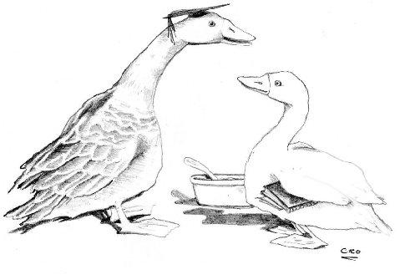
Sauce for the goose
We’ve got a grip on learning how to learn (LHTL) for pupils
We need to use growth in social networking as a vehicle for promoting LHTL for staff
I’ll have what he’s having!”

Slide 8
Contact Details
Philippa.cordingley@curee.co.uk
www.curee.co.uk
Centre for the Use of Research and Evidence in Education
4 Copthall House
Station Square
Coventry CV1 2FL
024 7652 4036

