Slide 1
Maximising the Impact of Mentoring and Coaching- an overview of the evidence
Paul Crisp and Lisa Bradbury
Centre for the Use of Research and Evidence in Education

Slide 2
The evidence - a settled picture
6 systematic reviews of the research evidence about what makes a difference in CPD
EPPI 1-4 re the impact of CPD
Timperley review
Practitioner Use of Research Review
Findings
Are remarkably consistent
Reflect but also refine evidence re pedagogy for pupils
Increasingly offer explanations of why things do and don’t work

Slide 3
Benefits of well structured professional learning
Positive links between structured, collaborative, sustained CPD and teacher ...
self confidence e.g. in taking risks and believing they can make a difference
willingness to continue learning and change practice
deeper knowledge & understanding of subject & pedagogy
wider repertoire of strategies & ability to match to needs
Positive links with improvements in students’...
motivation to learn
performance e.g. test results, specific skills e.g. maths & literacy, decoding, reading, problem solving
responses to specific subjects & curricula
organisation of work
use of collaboration as a learning strategy
questioning skills & responses
skills in & selecting and using wider range of learning activities
Notes:
This slide illustrates the outcomes for teachers. Points to highlight:
• Self efficacy. Concerns about the findings regarding self-efficacy may or may not come out in the plenary. This is often a good learning point because it involves what approaches to Thinking Skills such as CASE and CAME refer to as “cognitive tension or conflict”. The potentially counter-intuitive findings were that the pupils of teachers who developed a strong sense of personal efficacy (as opposed to developing an increased belief in the power of the professional as a whole to make a difference to learning) tended to achieve more but also emerged with more negative attitudes to learning and less motivation. There isn’t clear explanation for this in the research but a discussion of different hypotheses can be helpful in encouraging consultants to talk about their core beliefs about learning and teaching and, in particular, learning how to help teachers to learn how to do it. This may also be a helpful discussion in relation to the current emphasis on whole school approaches or climates for professional learning. A focus on enhancing professional practice across the school and the profession more widely might be an important counter balance against over performing star teachers who invoke feelings of dependency in others.
• wider repertoire The key point here is not only that the teachers could draw on a wider range of strategies – but also that they felt much more confident about deploying them at short notice in response to particular student needs.
• Willingness to continue professional learning. This is striking because the teachers’ accounts of their learning are often quite troubled. Things almost always got worse before they got better. As the teachers tried out new approaches, tried and tested routines or strategies they hardly knew they were using ceased to work. Evaluation at the end of seminars or workshops or even at the end of the programme were quite often negative. It was often only over a longer time frame that teachers became very positive about the learning process and its outcomes. There are implications here for colleagues to consider in relation to the aims for specific inputs and seminars...

Slide 4
Characteristics of CPD with these positive outcomes from across all 4 reviews
The use of specialist external expertise – combined with
Peer support to create trust, enable risk taking, generate commitment and “Safety To Admit Need” (STAN) – reciprocal vulnerability is key
Observation & deconstruction from specialists (what isn’t within reach on one’s own)
Scope for participants to identify own CPD focus & starting points (within a framework – table d’hote)
Working through lens of aspirations for students
Notes:
Characteristics of CPD with these outcomes
Points that may not be self explanatory or that are worth highlighting:
• emphasis on peer support. Colleagues become committed to sustaining the learning in order not to let each other down. The fact that peers were equally and reciprocally committed to learning to develop their practice was important to establishing trust and making it safe to admit need or uncertainty;
• observing other people (not necessarily experts) and having chance to explore a range of possible interpretations was as important as being observed and receiving feedback from specialists;
• observation was carefully set up for learning and protected from accountability systems;
• careful and joint work to identify starting points – what teachers knew, believed and could do already and what their concerns were in relation to their pupils’ learning were crucial and took many forms;
• identifying starting points was often closely linked to/managed through refining enquiry goals and learning foci.
(All the other bullets are unpacked in subsequent slides)

Slide 5
Characteristics of CPD with these positive outcomes from across all 4 reviews
Processes to
extend & structure professional dialogue re, eg beliefs re pupils, learning , teaching & the curriculum
Enable observation for learning coupled with shared analysis/debriefing
Encourage reflection rooted in evidence from experiments
Effective use of time to embed practices in classrooms e.g. on-course planning

Slide 6
The role of specialists
The importance of supporting both initial instruction; and
Setting up and facilitating on-going embedding of learning especially via peer support
If specialists try to do it all they face a huge burden re time and the skills to build trust because of power imbalances
Role of specialists is crucial in enabling bespoke & embedded CPD activities and processes
But specialist contributions are sometimes seen as antithetical to bespoke and peer owned approaches

Slide 7
How do effective specialists work?
The skills to facilitate key components identified plus
Scaffolding growing independence
Encouraging, enabling and structuring peer support
Focusing work based learning through lens of needs of pupils
Building skills in evaluating impact
Enabling alignment with other priorities
Creation of a professional learning environment
A mix of content, theoretical and evaluation skills
Ability to tailor development processes to working patterns to sustain and embed learning within the grain of classroom life

Slide 8
The link with coaching
The studies and programmes with positive effects all contained very similar processes
Some called the collaborative element peer support, others peer coaching, research lessons study, collaborative enquiry , conferencing etc
All also involved specialist external support – some called this coaching, others consultancy, facilitation, tutoring, mentoring
This evidence, together with fieldwork to capture current practice in England, underpins the national coaching and mentoring framework

Slide 9
The National Mentoring and Coaching Framework
Framework
Coaching has been enshrined in Professional Standards, NPQH etc and is central to Teaching School remit comprising:
a set of 1+10 principles for outcomes focused on coaching and mentoring
a summary of the skills involved in mentoring and in specialist and co-coaching
a summary of core concepts – the why, what, who, where and when of coaching and mentoring
a diagram comparing mentoring and coaching showing how activities overlap

Slide 10
Why have a national framework?
A means of sharing and extending current practice
Notes:
Could be ommitted?

Slide 11
Effective coaching and mentoring involves:
A learning conversation
A thoughtful relationship
A learning agreement
Combining support from fellow professional learners and specialists
Growing self direction
Setting challenging and personal goals
Setting challenging and personal goals
Understanding why different approaches work
Acknowledging the benefits to the mentors and coaches
Experimenting and observing
Using resources effectively

Slide 12
Principles
A learning conversation
A thoughtful relationship
A learning agreement
Combining support from fellow professional learners and specialists
Growing self direction
Setting challenging and personal goals
Understanding why different approaches work
Acknowledging the benefits to the mentors and coaches
Experimenting and observing
Using resources effectively

Slide 13
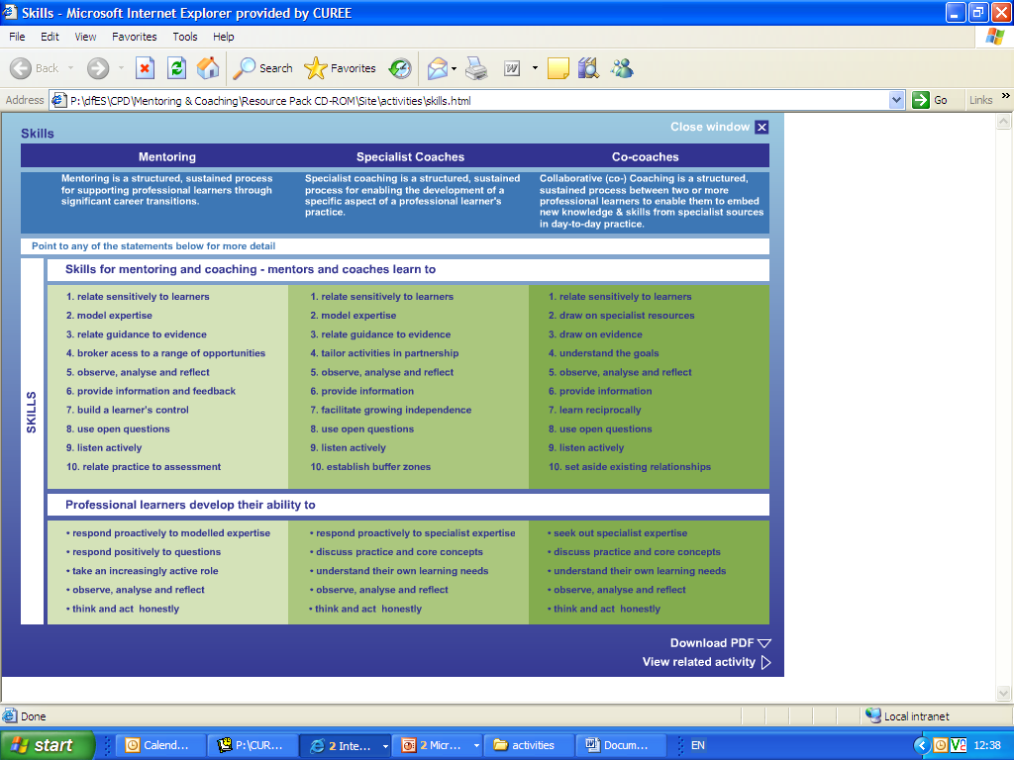
Skills for professional learning
Notes:
Key thing here is to illustrate one skill – active listening and then show how the framework works in different contexts

Slide 14
The potential and function of coaching
Quality of mentoring and coaching highly variable :
evidence from two OfSTED reports; and
evaluation of 75 CPD providers for TDA
Weaker practice abounds
Key issues in relation to the evidence base include:
Lack of clarity re purposes different approaches
Dominance of GROW model asserting need for specialist coaching, but not content knowledge , or skills
Confusion between leadership and pedagogic coaching
Insufficient emphasis on the skills of learners too much on the skills of coaches
Insufficient connections with pupil learning

Slide 15
Choosing questions to ask
Watch an extract from a clip of a real, but recontexualised coaching conversation between Jane and Matthew
If we look at Matthew and the skills framework, we can see some very common errors and thus skills he needs to develop – and some skills in use
Notes:
To do this you’ll need copies of the skills framework

Slide 16
Professional learning skills
If we look at Jane against professional learning skills we start to notice where she could contribute more
What skills from framework might she need to develop?
No coachees interviewed after sessions identified asking questions as a skill they contributed. When asked why...
They were anxious about asking ?s – they thought it might lead to lengthy answers or open up the coach’s agenda & move focus away from their own
So we mapped skills & behaviours of Coachees in much more detail & provide tools to secure quality for them and help specialist coaches “ let go”
Notes:
You could give them a couple of minutes to look at the PL skills here after first two bullets. If yo do that you’ll need to animate so you can delay the last 3 bullets

Slide 17
Evaluation of provision for TDA
Key areas
collaborative and sustained CPD
help improve outcomes for children and young people
based on effective needs analysis
encourage participants to be reflective practitioners
Benchmarks - Goal descriptors – 4 levels
informing
influencing
embedding
transforming

Slide 18
Four key areas: overview of findings
In nearly all cases the four elements (collaboration, reflection, needs analysis and helping improve outcomes for children) featured in some form
Circa 90% provision was informing or influencing
Reflection was the area in which we observed ‘embedding’ and ‘transforming’ provision most frequently, needs analysis – least frequently

Slide 19
Helping improve outcomes for CYP- findings from evaluating 75 CPD providers
This area was:
‘not observed’ in 1% of provision
Just under half of provision (48%) was ‘informing’
41% - at ‘influencing’
9% - at ‘embedding’
None – at transforming

Slide 20
Longer course= deeper engagement and higher impact?
On the whole, there needed to be multiple days for provision to be embedding or transforming
But:
over a third of provision lasting 8 days or more – at informing level
half a day or less sessions – could be influencing or even embedding

Slide 21
What did in-school provision look like?
Often CPD practice observed in school differed little from out of school provision
But distinguishing features in best sites included:
Facilitators able to model practice with participants’ own learners
Reflection closely linked to the participants trying things in own classrooms
On-going collaboration and facilitators being able to respond to emerging needs
CPD for individuals informed by school strategic objectives

Slide 22
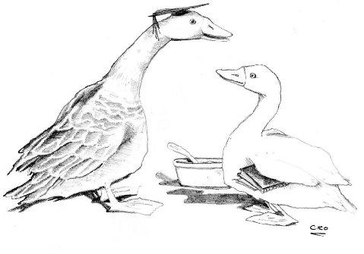
Orientation to learning requires
Creative use of time and other resources to protect and sustain learning
Viewing professional learning as an opportunity to mirror and model pupil experiences;
I’ll have what he’s having

Slide 23
The potential and function of coaching in whole school contexts
Evidence from the evaluation of CPD provision for TDA ( also presented at this conference) highlights a particular challenge or “stand off” between schools and providers re how to embed learning from programmes in day to day practice
Mixing specialist coaching ( eg on the day) and collaborative coaching (back in school) is an obvious, under- understood answer
Major emphasis on coaching as a tool for effective curriculum development highlighthed in new management of curriculum change research reported here at BERA

Slide 24
Contact Details
paul.crisp@curee.co.uk
lisa.bradbury@curee.co.uk
You can find reports mentioned here on our web site
You can find this presentation at
www.curee.co.uk
Centre for the Use of Research and Evidence in Education
4 Copthall House
Station Square
Coventry CV1 2FL
024 7652 4036

