Slide 1
Sauce for the Goose: learning environments that work for pupils and staff
Philippa Cordingley and Lisa Bradbury
Centre for the Use of Research and Evidence in Education (CUREE)

Slide 2
Sauce for the Goose
Objectives are to:
Understand what effective practice in aligning:
staff CPD; performance management; school improvement and pupil learning processes and outcomes
Look like as an effective learning environment
Identify key features of effective practice derived from your experience, egs and the international evidence
Identify 1-2 practical approaches to developing and sustaining quality in CPD and connecting staff and pupil learning for your context

Slide 3
Session map
We’ll contextualise with a reminder of effective learning environments in classrooms
Then we will unpack a case study of an effective learning environment for staff and for pupils
Then we will connect that with the international evidence base and current patterns in England
And finish up working out what it means for you in school – next steps
Key to it all is identifying 3 case study teachers and their pupils to keep in mind throughout.

Slide 4
Alf Coles – making algebra meaningful by changing classroom culture
Focus on becoming mathematicians. Researched it and decided as a class that
Mathematicians think for themselves,
notice and write about what they do,
ask why things work,
are organised and look for patterns
Results
Reached, in effect success at GCSE level in 15 weeks eg using symbols to express own ideas and asking can we do this for N?” in problem solving

Slide 5
Classroom culture changes via:
Spotting and celebrating these behaviours and creating tasks that generate them
Choosing tasks to reflect values –e.g. Common Boards where students pinned work for comment/ checking by others against frameworks on the boards or recorded results for other students to analyse/ classify
Emphasising students writing down their mathematical actions and reflections

Slide 6
Key underpinning processes
Needs assessment
Using common boards and writing down actions and reflections
Encouraging collaboration
Pinning up work for comment and sharing results for others to work on
Using evidence
Researching what makes a good mathematician

Slide 7
Key underpinning processes
Specialist expertise
Confidence to let go of control and open up learning processes
Leading learning
by making it visible, symbolising importance
modelling a belief in the potential for success;
evaluating impact formatively and summatively and
using tools e.g. assessment frameworks

Slide 8
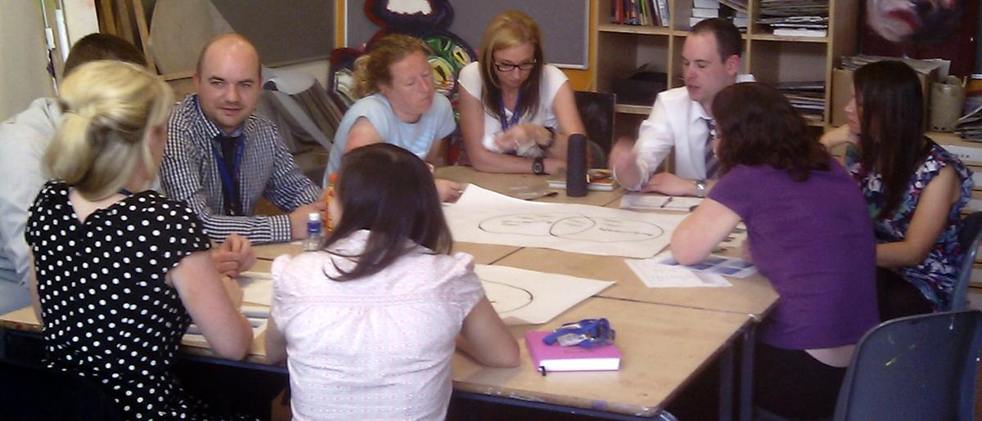
An effective learning environment for staff – Kenton school
Deputy head and CPDL leader designs and leads a Professional Learning Programme (PLP) for all Staff
PLP via regular, timetabled sessions, 1-2 full days, encouraging degree and M level study
PLP provides a mix of approaches e.g. interactive whole school sessions, departmental/phase groups and research and development groups

Slide 9
Kenton school
PLP underpinned by co-coaching approach for all staff
Identified partners work x departments and roles
supported by trained co-coaching champions and practical tools and resources to sustain quality
and graphic route maps - a guided pathway through research summaries, micro enquiry tools, videos etc
Staff choose support/ activities, from a range, in context of their specific goals/targets
Notes:
Insert hyperlink to slide wityh gilbertstone

Slide 11
Kenton school
PLP underpinned by co-coaching approach for all staff
Identified partners work x departments and roles
supported by trained co-coaching champions and practical tools and resources to sustain quality
and graphic route maps - a guided pathway through research summaries, micro enquiry tools, videos etc
Staff choose support/ activities, from a range, in context of their specific goals/targets
Notes:
Insert hyperlink to slide wityh gilbertstone

Slide 12
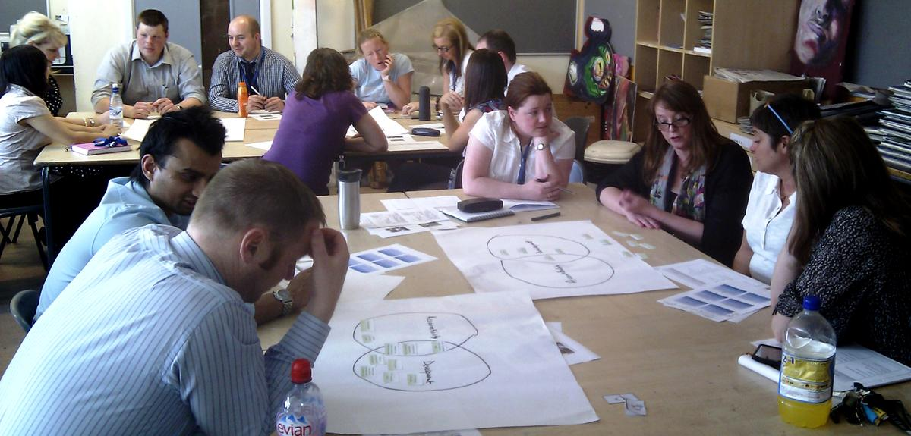
Kenton school
Newly emerging needs and proposals for innovation accommodated if case is made re achievement
Specialist expertise from beyond the school is valued –and carefully vetted by the head or CPD leader
The CPD Leader draws on data &consults staff extensively re the PLP offer

Slide 13
What does this say about effective learning environments for staff?
In small groups unpick the case study to:
Identify 3-4 key characteristics of an effective professional learning environment from this eg and your experience
If you have time, try to identify 1-2 ways this is similar to/different from an effective learning environment for pupils

Slide 14
Key underpinning processes
Collaboration
Strategic way of deepening ownership, making tacit explicit, embedding specialist contributions
E.g. Co-coaching, R&D teams
Needs assessment
Should be summative & formative via both Performance Management and CPD processes
E.g. Coaching champions and route maps – (formative) , PM ( summative) mid reform at present

Slide 15
Key underpinning processes
Evidence for learning
Research tasters for co-coaching, evidence collected by R&D groups & videos
E.g. Student tracking, work scrutiny & learning walks
Specialist expertise
To illustrate possibilities, challenge “group think” & focus on highest impact/doing few things really well
E.g. Extensive use of in-school and external specialists & specialist resources in PLP sessions

Slide 16
Key underpinning processes
Leadership - Modelling, prioritising, evaluating impact, tools
Modelling – e.g. SLT join in all PLP e.g. co-coaching
Prioritising CPD – e.g. by using real jobs as drivers (curriculum development , planning SOW)
Evaluation – e.g. collecting and synthesising evidence from across tasters/co-coaching goals and outcomes
Tools – e.g. open space techniques, PM (in future), learning walk protocols, work scrutiny

Slide 17
Effect sizes for leadership interventions
Promoting and participating in teacher learning ( 0.84)
Planning, coordinating and evaluating teaching and the curriculum ( 0.42)
Establishing goals and expectations (0.35)
Strategic resourcing ( 0.34)
Ensuring an orderly and supportive environment (.27)

Slide 18
Key underpinning processes
Leadership - Modelling, prioritising, evaluating impact, tools
Modelling – e.g. SLT join in all PLP e.g. co-coaching
Prioritising CPD – e.g. by using real jobs as drivers (curriculum development , planning SOW)
Evaluation – e.g. collecting and synthesising evidence from across tasters/co-coaching goals and outcomes
Tools – e.g. open space techniques, PM (in future), learning walk protocols, work scrutiny

Slide 19
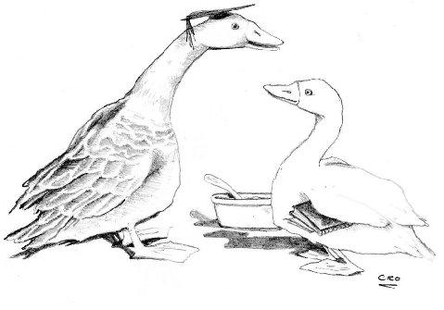
Sauce for the Goose
Too much focus on teaching & leading teachers instead of focussing on their learning?
Learning for staff, as for young people, depends on recognising, reviewing, challenging and building on what people know, understand and believe already.
But also on wrapping this around the day job
http://tinyurl.com/bs24e83
“I’ll have what he’s having!”

Slide 20
How are we doing? Skein evidence
Data collection methods include:
Group interviews with SLT
Focus group(s)
Individual interviews with a sample of staff
Staff survey
Documentary analysis
Evidence analysed against research-based benchmarks
Report, recommendations and follow-up for individual schools and across schools

Slide 21
Findings
Identified some good and innovative practice but
some persistent challenges emerging, even from
good and outstanding schools.
Differentiation/ needs analysis is one
Discuss with a partner:
If you think of your staff as your class – would you award your school staff learning environment 1, 2, 3 or 4 for needs analysis/ differentiation?
What would your staff say?

Slide 22
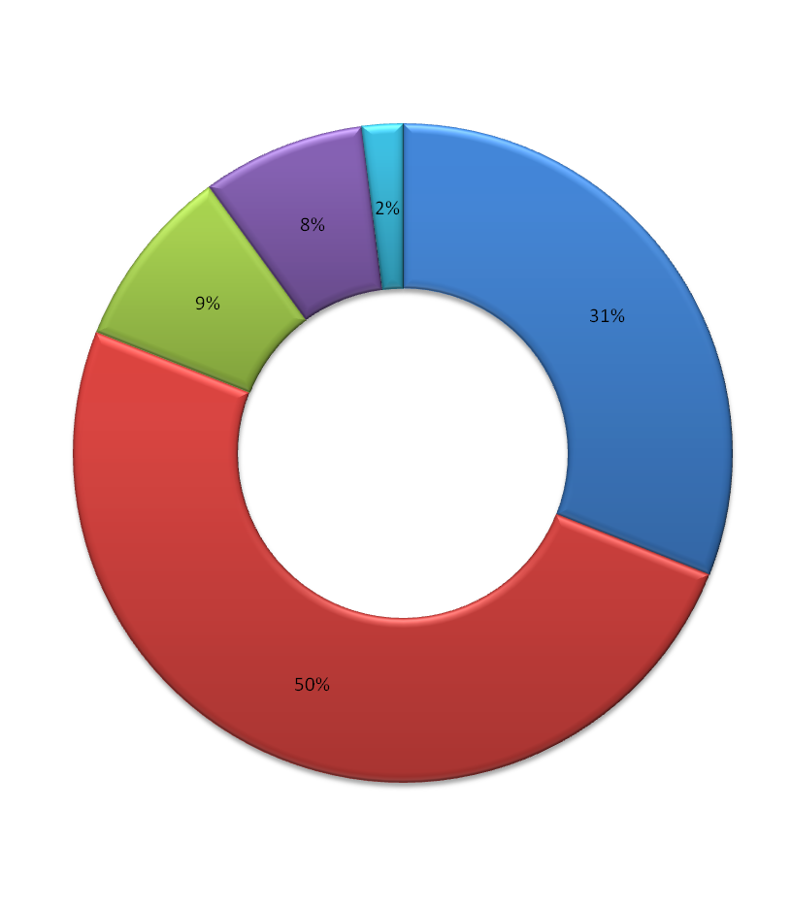
Differentiation : Staff attitude to whole school CPD sessions
A bit of a waste of time
Helpful to 1-2 people
Usually useful
n=400
Sometimes useful

Slide 23
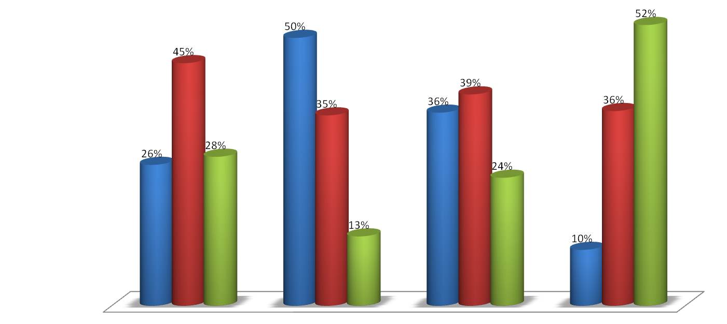
Of the 5 recent CPD opportunities, how many
none
1-2
3 and more
Chose yourself
From Line manager/ SLT
Whole school target
From Coaching/PM

Slide 24
Differentiation
Whole school CPD is main way whole school priorities are met - 75% of SKEIN schools
Over 50% of school staff report that the bulk of the CPD was targeted at whole school priorities and…
Nearly 20% of staff found whole school sessions largely irrelevant, another 50% could only sometimes link them to their practice.
This was less true in primary school than secondary schools but even there personalised, differentiated learning was challenging in whole school contexts.

Slide 25
Differentiation-some good examples
Churnett View use learning walks & scanning pupil data to set whole school targets and identify ambitious, personal third PM target. They match CPD offer to analysis from data across school, phase and subject and personal targets
Classroom enquiry, mentoring support and wrapping CPD around day jobs were key matching tools
Castle school provided hosts to guide people around their annual market place of good practice to ensure learning is personalised.
If you have good ideas for personalising whole school CPD
session do let us know so we can celebrate and disseminate
best practice.
Notes:
Need example form primary

Slide 26
Collaboration and coaching
Over 75% of schools cited coaching as a key approach to CPD in group leadership interviews,
But only 26% said they were involved in coaching regularly and
52 % of survey respondents said they were involved in coaching at most once a year (usually in PM discussions)
Despite the investment of time and resources, schools and their staff often realise only a fraction of the potential benefits of these important professional development processes.

Slide 27
Prioritising for your context
Thinking of your 2-3 case study teachers
Chose a benchmark where you would like to develop the learning environment further:
Collaboration; Needs analysis, Specialist expertise; Evidence for learning; Leadership of professional learning
Identify something you want to change/refine and something you want to explore further
If you write your goal and your email address on the enquiry form we will send you examples of good practice from SKEIN( where we have them)

Slide 28
Collaboration and coaching
Over 75% of schools cited coaching as a key approach to CPD in group leadership interviews,
But only 26% said they were involved in coaching regularly
52 % said they were involved in coaching at most once a year (often in PM meetings)
Despite the investment of time and resources, schools and their staff often realise only a fraction of the potential benefits of these important professional development processes.

Slide 29
Thank you for all your hard work and
engagement
Do come and talk to us if you would
like to find out more

Slide 30
Links to the evidence base
Sauce for the Goose - http://tinyurl.com/bs24e83
EPPI 4 - http://tinyurl.com/d98986w
Robinson - http://tinyurl.com/bwamjrc
Timperley- http://tinyurl.com/8vnhxhl
Pearson – http://tinyurl.com/9ahw58k
PLC -http://tinyurl.com/9upfk6c
AITSL - http://tinyurl.com/8w6gvl3
Notes:
Links to be inserted

Slide 31
Contact Details
philippa.cordingley@curee.co.uk
lisa.bradbury@curee.co.uk
www.curee.co.uk
Centre for the Use of Research and Evidence in Education
4 Copthall House
Station Square
Coventry CV1 2FL
024 7652 4036

